Slide 1
EMB COMP PKG measuring instrument
We are looking for a supplier or method to obtain a plug gauge to verify the threads on parts 390-61530-401 and 391-63975-403.
Although we have requested quotations from multiple gauge manufacturers, most of them responded that production is not feasible. One supplier did produce the gauge; however, the calibration results showed that the minor diameter tolerance could not be met.
If EMB has any information regarding a reliable source or supplier for this type of gauge, we would appreciate it if you could share it with us so that we can proceed with a quotation request.
Please refer to the following page for the required plug gauge.

Slide 2
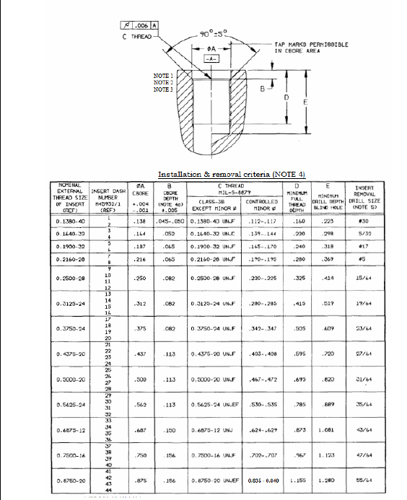
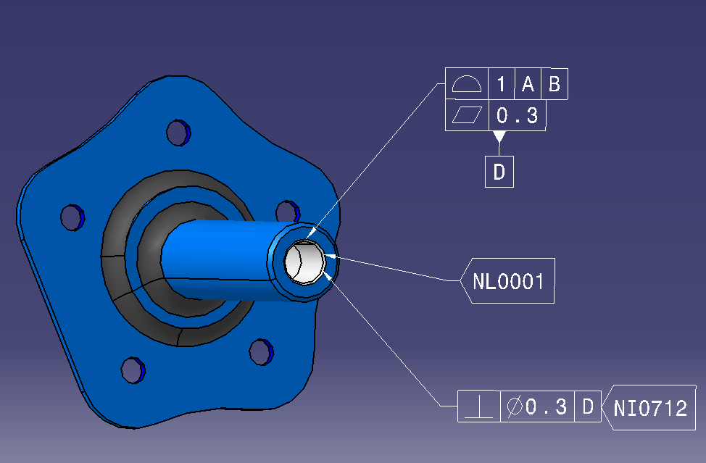
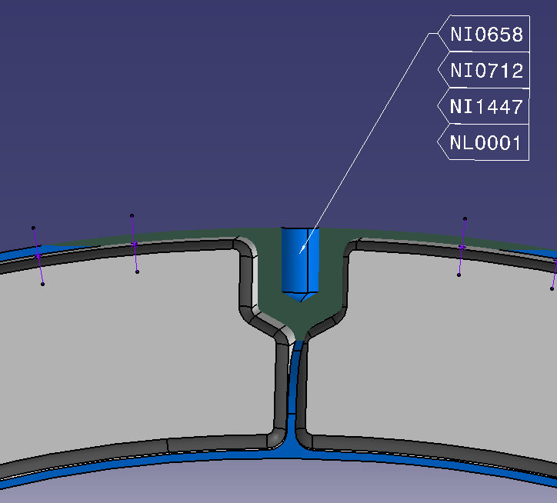
EMB COMP PKG measuring instrument
NE06-028
- 391-63975-403-DA
3750 - 24 UNJF 3B per AS8879
(**Minor S/B : .342 ~ .347)
.5625 - 24 UNJEF 3B per AS8879
(**Minor S/B : .530 ~ .535)
- 390-61530-401-DA

